Slide 1
Protecting and Sharing Documents
Microsoft Word 2013
Lesson 13

Slide 2
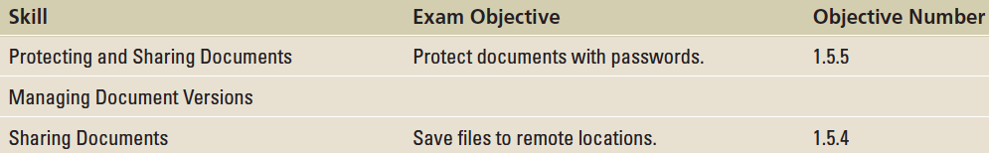
Objectives

Slide 3
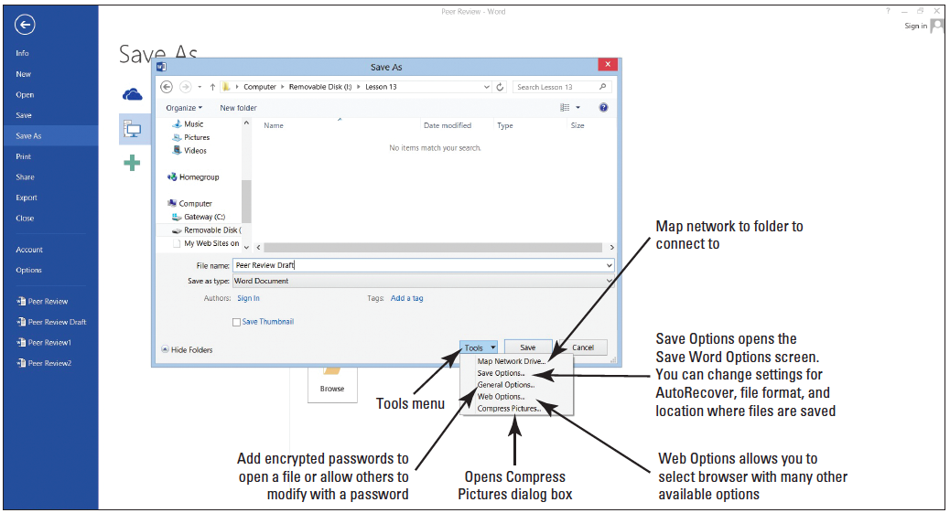
Step by Step: Set an Access Password for a Document
OPEN the Peer Review document from the lesson folder.
SAVE the document as Peer Review Draft in the lesson folder on your flash drive.
In the Save As dialog box, click the Tools button as shown at right.

Slide 4
Step by Step: Set an Access Password for a Document
Select General Options from the menu. The General Options dialog box appears. Once a password is entered to open and modify the document, the file will be encrypted. When a file is encrypted, the data is converted to a code.

Slide 5
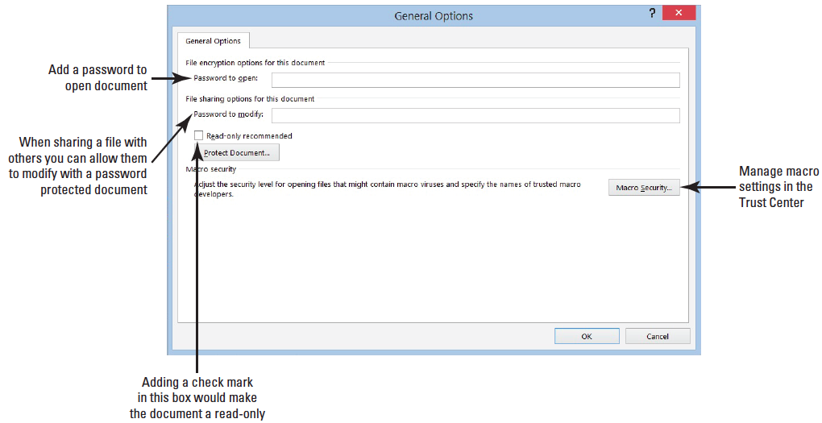
Step by Step: Set an Access Password for a Document
Type HR%form$# in the Password to open box (below). Word enables you to specify two pass- words—one to open a document and one to modify a document— both are optional. You can specify passwords for both actions—or specify a different password for each action. Passwords are case-sensitive. For this exercise, use the same password to open and modify. In the Password to modify box, type HR%form$#.

Slide 6
Step by Step: Set an Access Password for a Document
Click OK. The Confirm Password prompt appears. A warning appears stating that if you lose or forget your password, you will not be able to recover your document. Keep all passwords in a safe place in case you need to refer back to them. Reenter the password to open the document.
Type HR%form$# in the Reenter password to open box and click OK. The Confirm Password prompt opens.
Reenter the same password to modify the document.

Slide 7
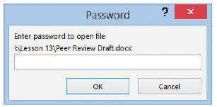
Step by Step: Set an Access Password for a Document
When entering passwords, it is recommended that you enter a strong password that is mixed with characters and symbols.
Click Save in the Save As dialog box and CLOSE the file.
Open the document and a Password prompt appears to open the document, as shown below.
Type HR%form$# in the box and click OK.

Slide 8
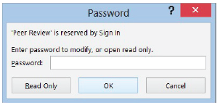
Step by Step: Set an Access Password for a Document
The Password prompt opens again, but this time you reenter the same password to allow for modifications. Only those individuals who are provided this password will be allowed to edit the document (below).
PAUSE. LEAVE the document open to use in the next exercise.

Slide 9
Step by Step: Remove a Password
Click the File tab and notice the Protect Document button is highlighted in a light yellow color. Under Protect Document it states, “A password is required to open this document.”
Select Save As and select the Browse button to open the Save As dialog box.
Click the Tools button, and then select General Options from the menu.
Remove the password protection by selecting the hidden passwords and press Delete.

Slide 10
Step by Step: Remove a Password
Click OK.
SAVE the document as Peer Review1 in your flash drive in the lesson folder.
You now have two copies of the same document: one with a password and one without.
PAUSE. LEAVE the document open to use in the next exercise.
Notes:
Take Note: It is important for you to remember your password. If you forget your password, Microsoft cannot retrieve it for you. Record and store your password in a safe location, such as, placing it in your security safe or a secure place at home. Use strong passwords that combine uppercase and lowercase letters, numbers, and symbols. Weak passwords do not mix these elements. An example of a strong password is W5!dk8aG; a weak password is CAR381. Passwords should be 8 or more characters in length. A password phrase that uses 14 or more characters is better.

Slide 11
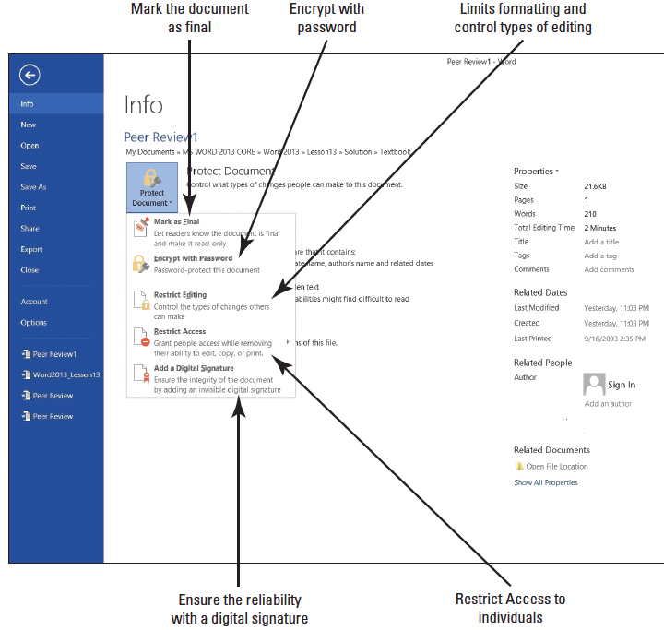
Step by Step: Protect a Document as Read Only
USE the document open from previous exercise.
OPEN Backstage, and then click Protect Document to display the menu.
Click Restrict Editing as displayed at right.

Slide 12
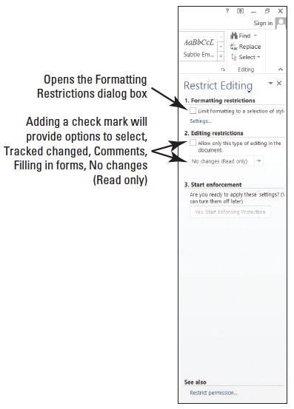
Step by Step: Protect a Document as Read Only
The Restrict Editing pane displays on the right pane on your screen as shown at right. Item one is the Formatting restrictions, which is where you determine what type of formatting changes are allowed.
The second item is Editing restrictions, No changes (Read only). You control the limitations on editing.
Notes:
Another Way: There are two other ways to open the Restrict Editing pane: from the Developer tab, select Restrict Editing; from the Review tab.

Slide 13
Step by Step: Protect a Document as Read Only
Add a check mark by Allow only this type of editing in the document. By default, No changes (Read only) is selected as the first option.
In the third item, Start Enforcement, click Yes, Start Enforcing Protection.

Slide 14
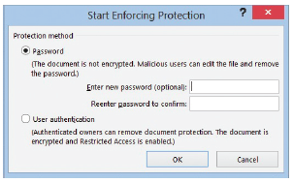
Step by Step: Protect a Document as Read Only
The Start Enforcing Protection dialog box opens as shown at right.
The Start Enforcing Protection turns on the set restriction to begin restricting the document as a Read only type of document.
The first option shows that by adding a password, the document will not be encrypted.

Slide 15
Step by Step: Protect a Document as Read Only
User authentication adds an encryption to the document with the restricted access enabled preventing sensitive documents from being printed, forwarded, or copied.
Before you can use User authentication, your computer must be set up for the Information Rights Management (IRM).
Type BYA$%HRDept in the Enter new password box and Reenter password to confirm box, and then click OK.

Slide 16
Step by Step: Protect a Document as Read Only
The document is now protected from any editing, and only you may view this region.
A region is the location in the document that you are allowed to edit.
The Restrict Editing pane displays two available options: Find Next Region I Can Edit and Show All Regions I Can Edit.
This displays the areas in your document that you have been granted permission to edit.

Slide 17
Step by Step: Protect a Document as Read Only
Click the first button and notice that Word states that it has finished searching the document—there were no regions highlighted.
Click the second button and no regions are highlighted. This is a read only document, so no editing is allowed.
Click the Stop Protection button at the bottom of the pane.

Slide 18
Step by Step: Protect a Document as Read Only
To unprotect the document, in the Unprotect Document dialog box, enter the password BYA$%HRDept and click OK.
Click Allow only this type of editing in the document box to remove the check mark.
Close the Restrict Editing pane.
SAVE the document in the lesson folder on your flash drive.
PAUSE. LEAVE the document open to use in the next exercise.

Slide 19
Step by Step: Restrict a Document with Comments Only
USE the document open from the previous exercise.
On the Developer tab in the Protect group, click the Restrict Editing button. The Restrict Editing pane opens.
Add a check mark by Allow only this type of editing in this document.
Click the drop-down arrow and select Comments.

Slide 20
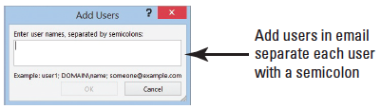
Step by Step: Restrict a Document with Comments Only
You can practice this exercise on your own or you can pick someone in class to edit your document. If you pick someone in class, click the More Users… link and enter the person's e-mail address, (for example, user name@live.com in the Add Users dialog box). See below.

Slide 21
Step by Step: Restrict a Document with Comments Only
More than one user can be added in the dialog box as long as you separate the e-mail address with a semicolon. Click OK.
Add a check mark by the e-mail address. Once the recipient receives the e-mail, he or she will be able to edit the document and add comments. No other editing features will be enabled.
In the Start Enforcement section, click the Yes, Start Enforcing Protection button. The Start Enforcing Protection dialog box opens, which turns on the set restriction for comments only.

Slide 22
Step by Step: Restrict a Document with Comments Only
Type BYA$%HRDept in the Enter new password (optional) box and in the Reenter password to confirm box, and click OK.
Only comments can be added to the region. As mentioned previously, a region is the area in the document where you are allowed to make changes.
Click Show All Regions I Can Edit; the insertion point moves to the heading. Then select Jill A. Williams, insert a comment, and type Jill’s middle initial is E. The comment appears alongside of the document.

Slide 23
Step by Step: Restrict a Document with Comments Only
Click the Stop Protection button at the bottom of the Restrict Editing pane.
The Unprotect Document dialog box is displayed.
Type BYA$%HRDept and click OK.
Click the Allow only this type of editing in the document box to remove the check mark.
SAVE the document as Peer Review2 in the lesson folder on your flash drive.
PAUSE. LEAVE the document open to use in the next exercise.
Notes:
Cross Reference: In Lesson 9, you learn about inserting, editing, and deleting comments.

Slide 24
Step by Step: Limit Formatting Styles in a Document
USE the document open from the previous exercise.
In the Formatting restrictions section, click the Limit formatting to a selection of styles check box.
Selecting this option enables you to set formatting restrictions for this document.

Slide 25
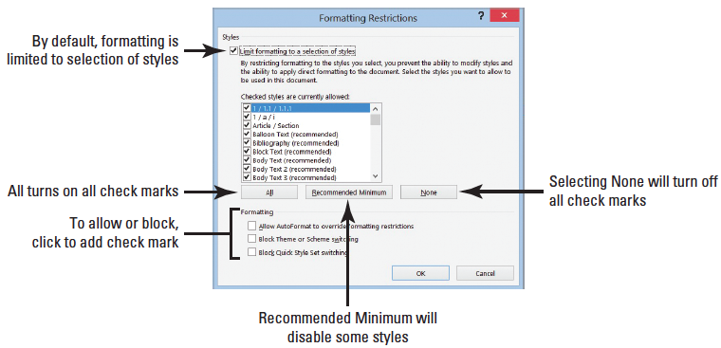
Step by Step: Limit Formatting Styles in a Document
Click the Settings link. The Formatting restrictions dialog box opens, as shown below. The check mark indicates that styles are allowed.

Slide 26
Step by Step: Limit Formatting Styles in a Document
Under the Formatting section, click the Block Theme or Scheme switching check box and then click OK. Selecting this option blocks the user from making any changes to the structure, pattern, or theme of the document.
A prompt appears on your screen stating that This document may contain formatting or styles that aren’t allowed. Do you want to remove them?
Click Yes. On the Design tab, in the Document Formatting group, notice that Themes is shaded gray making it unavailable.
In the Restrict Editing pane, click Settings again to open the Formatting Restrictions dialog box.

Slide 27
Step by Step: Limit Formatting Styles in a Document
Remove the check mark by Block Theme or Scheme switching.
Click OK.
Click Yes to the prompt to remove.Notice the Themes group is now available. You can now use the Themes commands in the group.
In the Formatting restrictions section of the Restrict Editing pane, click the Limit formatting to a selection of styles check box to remove the check mark.
Close the Restrict Editing pane.
SAVE the document with the filename Peer Review3 in the lesson folder on your flash drive.
In the Document Formatting group, of the Design tab, change the Style Set to Lines (Simple).

Slide 28
Step by Step: Limit Formatting Styles in a Document
The headings, Employee Information, Review Guidelines and Evaluation are not displaying correctly in the table.
Change the cell height to 0.3" to accommodate the content in those cells.
Change the font color to the heading and select White, Backgroung 1 and bold.
Keep the document open for ten minutes. Later in this lesson, you learn about managing versions.
Minimize the document to place it on the taskbar. You will use this document later in this lesson.
PAUSE. LEAVE the program open for the next exercise.
Notes:
Take Note: Restricting comments can be made to the whole document or you can select portions of the document where editing changes are allowed.

Slide 29
Step by Step: Mark a Document as Final
OPEN the Review Form document from the lesson folder.
SAVE the document as Review Form1 in the lesson folder on your flash drive.
Click the File tab, click Protect Document, and then click Mark as Final. A dialog box appears indicating that this document will be marked as final and then saved.

Slide 30
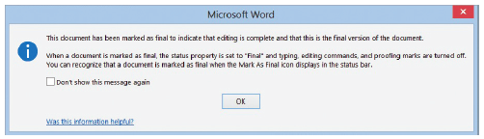
Step by Step: Mark a Document as Final
Click OK. A Microsoft Word prompt displays as shown below. The mark as final prevents recipients from making changes to the document—the document becomes read only and is displayed on the title bar. When a document is marked as final, the status property is set to Marked as Final and typing, editing commands, and proofing marks are turned off. Notice that the Marked as Final icon on the status bar.
Click OK.

Slide 31
Step by Step: Mark a Document as Final
The document is Marked as Final and displays in the Protect Document section highlighted in a light yellow color to discourage editing.
Return to the document and notice the yellow bar below the Ribbon indicating that An author has marked this document as final to discourage editing.
If you need to edit the document, click the Edit Anyway button.
Click any of the tabs on the Ribbon and notice these are shaded in gray indicating the commands are not available.

Slide 32
Step by Step: Mark a Document as Final
Continue to click the other tabs to view how the commands are not activated.
Select the title of the document and try to delete it. When a document is marked as final, typing, editing commands, and proofing marks are disabled, because the document becomes a read-only document. Notice the title bar also shows the document as a (Read-Only) document.
On the File tab, click the Protect Document button, select Mark as Final to return the document to its original status, and then return to the document.
Notes:
Another Way: On the document screen, click Edit Anyway to return document to its original status.

Slide 33
Step by Step: Mark a Document as Final
Select the B in Blue Yonder Airlines and press the Delete key. You can now make changes to the document.
Click the Undo button on the Quick Access Toolbar.
SAVE the document with the same filename in the lesson folder on your flash drive.
PAUSE. LEAVE the document open to use in the next exercise.
Notes:
Take Note: Documents that have been marked as ﬁnal in a 2013 Microsoft Ofﬁce program will not be read only if they are opened in earlier versions of Microsoft Ofﬁce programs. It is important to recognize that the Mark as Final command is not a security feature—anyone who receives an electronic copy of a document that has been marked as final can edit that document by removing the Mark as Final status from the document.

Slide 34
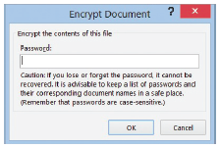
Step by Step: Encrypt a Document
USE the document open from the previous exercise.
Go to Backstage, click the Protect Document button, and then select Encrypt with Password. The Encrypt Document dialog box opens as shown at right. Encrypting protects the document by making it unreadable because it encrypts the information into a code.

Slide 35
Step by Step: Encrypt a Document
In the Encrypt the contents of this file box, type HRDept&%3.
Retype the password and click OK. Notice that Protect Document is highlighted and indicates that a password is required to open this document.
CLOSE the document.
Click Save when prompted with Do you want to save the changes you made to Review Form1?
Reopen the document and type HRDept&%3 to open the document.
Do not delete the password at this time.
SAVE the document as Review Form2 in the lesson folder on your flash drive, and then CLOSE the file.
PAUSE. LEAVE Word open to use in the next exercise.
Notes:
Take Note: To unprotect the document, you must already be inside the document (with the correct password). From within the document, select the Backstage tab, click the Protect Document button, select Encrypt with Password, delete the password from the dialog box, and select Save.

Slide 36
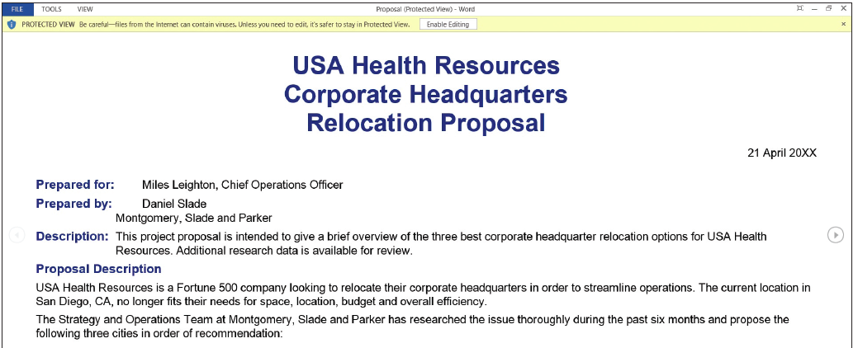
Step by Step: Open a Document in Protected View
OPEN the Proposal document from the lesson folder. The document opens in Protected View. The yellow prompt states This file originated from an Internet location and might be unsafe as shown below.
Notes:
Take Note: This document opens in Protected View on the author’s machine because Word is able to detect that she downloaded the file from an FTP site and saved it on her machine. However, if someone else receives the file from a trusted source (such as from a CD or a secure email), Word is able to detect this and open the file in normal view. Therefore, when you open this file, depending upon how you received the file, Word might actually not open it in Protected View. Unfortunately we cannot create a file that will always open in Protected View.

Slide 37
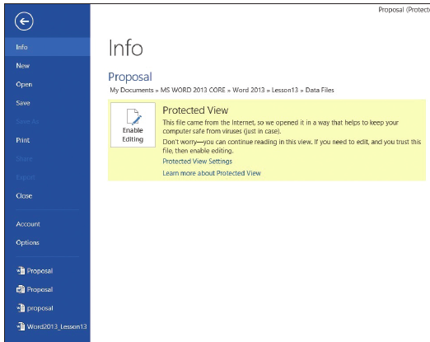
Step by Step: Open a Document in Protected View
Click the File tab.
Notice that the Enable Editing button is high- lighted in a light yellow color informing you that This file originated from an Internet location and might be unsafe (right).
When you are ready to edit the document, click the Enable Editing button on the yellow prompt.
CLOSE the document without saving.
PAUSE. LEAVE Word open for the next exercise.
Notes:
Another Way: Click the Protected View button in Backstage.

Slide 38
Step by Step: Manage Document Versions
On the taskbar, click the Peer Review3 document to make it the active document. Remember, you minimized this document previously in this lesson. The document should have been opened for approximately 10 or more minutes.
Select File to go to Backstage view. On the Info screen, under Manage Versions, you should see the times the document was saved.
Click Close without saving and keep Word open.
Closing the Word program loses your versions of the Peer Review3 document.

Slide 39
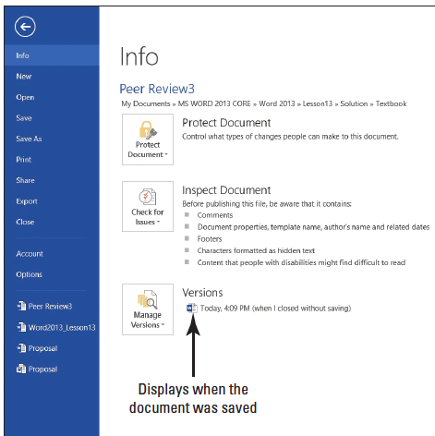
Step by Step: Manage Document Versions
OPEN the Peer Review3 document from your flash drive in the lesson folder.
Go to the Backstage Info screen; notice by Manage Versions, it shows Today, time, (when I closed without saving).
See the figure at right. Your screen will not match the figure.
In the Backstage view, select Options to open the Word Options dialog box.

Slide 40
Step by Step: Manage Document Versions
From the list in the left pane, select Save. By default, the Save AutoRecover information is set every 10 minutes. Also Keep the last autosaved version if I close without saving is enabled. In step 3, you closed the document without saving and when you reopened and reviewed the Managed Versions, it showed when the document was last saved in Autosave.
The default time for Save AutoRecover can be changed in the Word Options Dialog box.

Slide 41
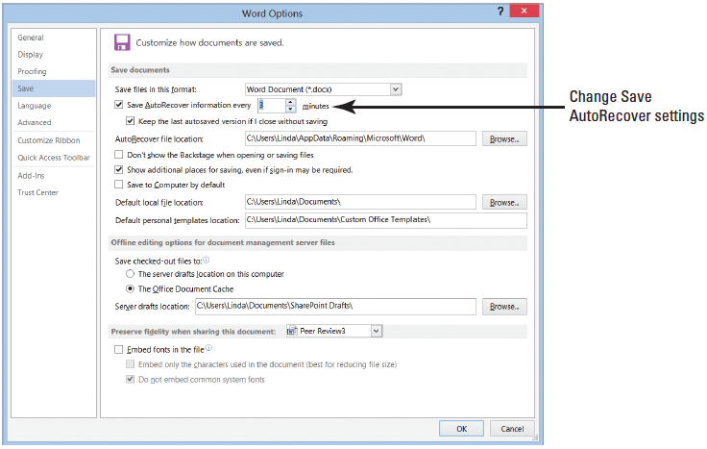
Step by Step: Manage Document Versions
Under the Save documents section, select the default 10 and type 3 minutes or click the down arrow by Save AutoRecover information as shown at right.
Click OK.

Slide 42
Step by Step: Manage Document Versions
Create a new blank document and type Working with unsaved documents can be found in Backstage in the Info screen. Keep this document open, until you are instructed to work on the next step.
On the View tab, click Switch Windows and select the Peer Review3 document.
Return to Backstage and under Versions, you should see at least one or two versions of the document saved.
SAVE the document in the lesson folder on your flash drive.
PAUSE. LEAVE the document open for the next exercise.
Notes:
Take Note: Clicking the down arrow key in Manage Versions allows you to Recover Unsaved Documents; the Open dialog box opens files specifically from the location where unsaved files are saved.

Slide 43
Step by Step: Restore an Earlier Version of Your Document
USE the document open from the previous exercise.
Select the Blue Yonder Airlines heading.
Change the font color to Dark Blue, Text 2.
Increase the font size to 28 pt.
Where Jill A. Williams’ name appears, replace A. with E.
Change the review period from Dec 20XX to April 20XX.
You need to modify the document in order for Autosave to save the updated changes.
Go to Backstage and under Versions, click the version where it indicates (autosave).

Slide 44
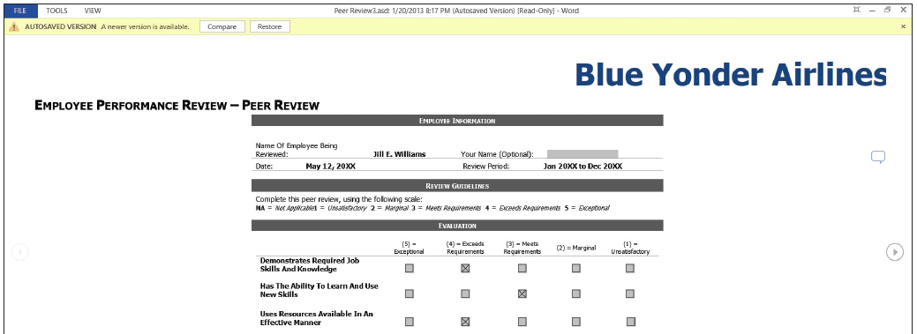
Step by Step: Restore an Earlier Version of Your Document
A new window opens showing a yellow bar below the Ribbon displaying, Autosave Version—a new version is available with two options available. One is Compare and the other is Restore. If your document contains only one autosave version, make sure you change the save settings and then modify the document (below).

Slide 45
Step by Step: Restore an Earlier Version of Your Document
When you click on Compare, a summary that compares the original document and the revised document displays on one screen. The Restore button prompts you to overwrite your previous document.
Click Restore to overwrite your previous document. Compare versions is one of Word’s advanced features; for more information, use Help.
You will be prompted to overwrite the last saved version with the selected version. Click OK.
CLOSE the document.
PAUSE. LEAVE Word open for the next exercise.

Slide 46
Step by Step: Recover Unsaved Documents
Previously you typed, Working with unsaved documents can be found in Backstage in the Info screen. And in a previous step, you changed the Save AutoRecover information from the default to three minutes.
CLOSE the document that you typed.
A prompt appears on your screen to save changes. The prompt states, If you click “Don’t Save,” a recent copy of this file will be temporarily available. It also indicates that a temporary file will be saved. If you do not see this, review the information in the Troubleshooting sidebar next.

Slide 47
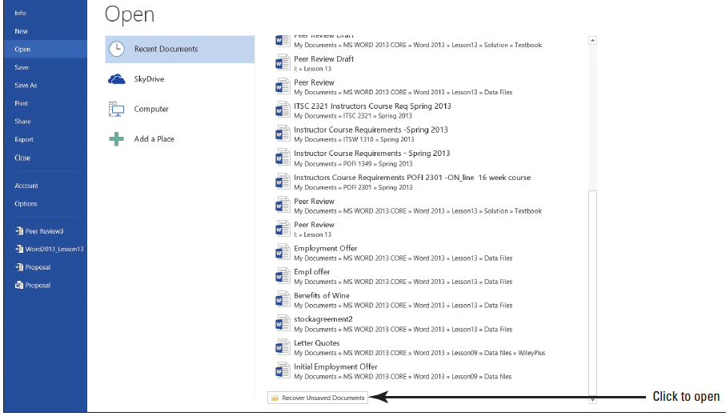
Step by Step: Recover Unsaved Documents
Click Don’t Save.
Click the File tab, and then click Open.
On the bottom right side of the screen, click Recover Unsaved Documents (above).
Your screen will not match this figure.
Notes:
Troubleshooting: If a prompt did not appear on your screen to save your document, you can change the AutoRecovery preferences from the default. The default for AutoRecovery is to save every ten minutes; it can be found in Backstage, Options command, in the Save settings category. For instructional purposes, you might need to change the settings to three or five minutes. Close the document without saving, and the prompt will indicate that the file will be temporarily saved.

Slide 48
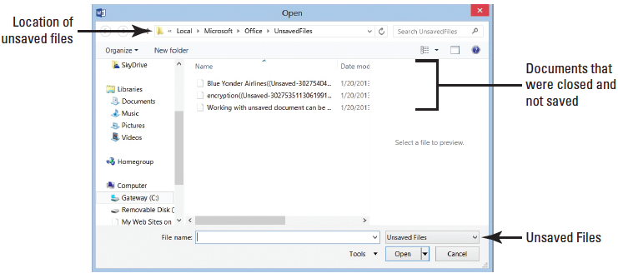
Step by Step: Recover Unsaved Documents
On the Open dialog box, locate your file based on the date and time you closed the document or program or locate Working with unsaved documents can be… (below).
The document was closed without saving it with a filename; therefore, the name will show the first part of the text that you typed. Unsaved documents are in a temporary location on your hard drive and identified by the .ASD file extension.

Slide 49
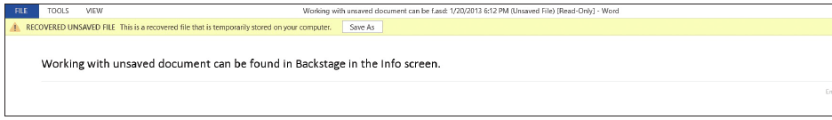
Step by Step: Recover Unsaved Documents
Select the unsaved document and click Open.The document opens with the Recovered Unsaved File yellow prompt appearing above the document stating, This is a recovered file that is temporarily stored on your computer.
Click Save As (below).
SAVE the document as Unsaved Document in the lesson folder on your flash drive.
PAUSE. LEAVE the document open to use in the next exercise.

Slide 50
Step by Step: Delete All Draft Versions
USE the document open from the previous exercise.
Click the File tab, click the Manage Versions button, and then click Recover Unsaved Documents. The Open dialog box for Unsaved Files opens. You should see the first few words of the document in the Open dialog box.
Click Working with unsaved documents can be . . . and right-click, and then select Delete.
Click Yes to the prompt, Are you sure you want to move this file to the Recycle Bin?
Select Cancel to close the Open dialog box.
CLOSE the Unsaved Document.
PAUSE. LEAVE Word open to use in the next exercise.
Notes:
Another Way: At the Open dialog box for Unsaved Files, click the Organize button and then click Delete. At the prompt, Are you sure you want to move this file to the Recycle Bin?, click Yes.
Take Note: Unsaved Documents are found in a specific location on your hard drive. A file extension of ASD has been assigned to unsaved documents. The files located in Recovering Unsaved Files are temporary files until saved.

Slide 51
Step by Step: Use the Document Inspector
OPEN the Employment Offer Letter document from your lesson folder. Notice that the documente opened in Compatibility Mode? Keep this in mind for later.
Open Backstage, click the Check for Issues button, then click Inspect Document. The Document Inspector dialog box appears.
This command checks for hidden properties and personal information.

Slide 52
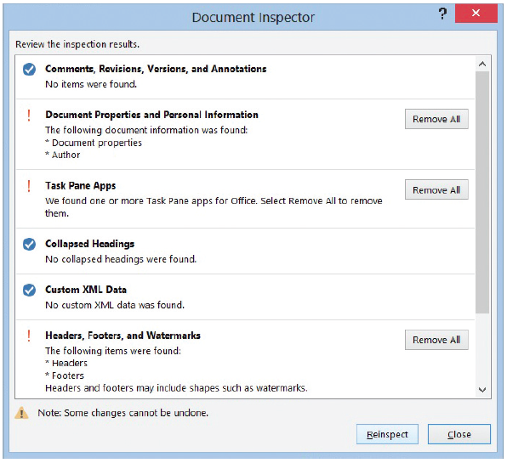
Step by Step: Use the Document Inspector
Click the Inspect button (right).
Word inspects the document and displays the results in the Document Inspector window. Three warnings appear in the Document Inspector.
In the Document Properties and Personal Information section, click Remove All.

Slide 53
Step by Step: Use the Document Inspector
Personal information from the properties is removed and the document is ready to be shared. The dialog box is updated.
Make no changes to Task Pane Apps and Headers, Footers, and Watermarks.
Click Close.
In the Inspect Document section, click the Allow this information to be saved in your file link.
SAVE the document as Employment Offer Letter1 in the lesson folder on your flash drive. You are prompted by Microsoft Word stating “Your document will be upgraded to the newest file format. Click OK.
PAUSE. LEAVE the document open to use in the next exercise.

Slide 54
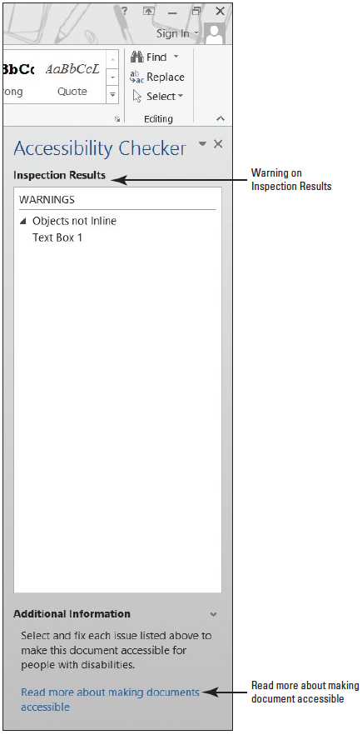
Step by Step: Use the Accessibility Checker
USE the document that is open from the previous exercise.
Open Backstage, click the Check for Issues button, and then click Check Accessibility. The Accessibility Checker pane appears on the right pane, as shown at right. If there are errors in your document, the Accessibility Check shows issues, warnings, or tips. In this case, a warning appears displaying Objects Not Inline.

Slide 55
Step by Step: Use the Accessibility Checker
Return to Backstage and below Inspect Document indicates that Content that people with disabilities find difficult to read. Word flags the document letting you know that there are potential problems in the document that not everyone will be able to read.
Return to the document.
In the Accessibility Checker pane, click Text Box 1 to select.
Notice that a text box appears in your document screen with Blue Yonder Airlines appearing very light in the background. Individuals with a disability would find this difficult to read.

Slide 56
Step by Step: Use the Accessibility Checker
With the text box selected, change the font color to Green, Accent 1, Darker 50%. Now that the color is changed on the heading, repeat step 2. The same warning appears because the object is not inline with text and a person with a disability might still experience problems reading this. To fix this problem, delete the Blue Yonder Airlines heading.
Select Text Box 1, and press Delete. Notice that the Accessibility Checker pane now displays as no accessibility issues found.
CLOSE the Accessibility Checker.
SAVE the document in the lesson folder on your flash drive.
PAUSE. LEAVE Word open to use in the next exercise.

Slide 57
Step by Step: Use the Compatibility Checker
USE the document that is open from the previous exercise.
When documents are created in an earlier version of Word and opened in newer versions of Word, they open in Compatibility Mode and display in the title bar. Previously, you opened the Employment Offer Letter and it opened in Compatibility Mode.
Even though you do not see Compatibility Mode on the title bar, this document still contains features from an older version that are no longer supported by the latest version of Word.

Slide 58
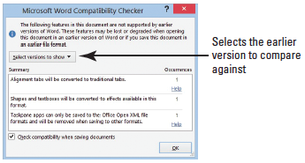
Step by Step: Use the Compatibility Checker
It is recommended that you run the Compatibility Checker to identify features that are supported in older versions.
Go to Backstage, click Check for Issues, and then click Check Compatibility.
The Microsoft Word Compatibility Checker dialog box is displayed as at right. When sharing Word 2013 documents with individuals using earlier versions of Word, your document will need to be saved in the Word 97-2003 format.

Slide 59
Step by Step: Use the Compatibility Checker
It is good practice to use the Compatibility Checker to ensure the features you have included in your document will not be removed or changed when you save it in the Word 97-2003 format.
The Compatibility Checker displays the message, The following features in this document are not supported by earlier versions of Word. These features may be lost or degraded when opening this document in an earlier version of Word or if you save this document in an earlier file format.
Click OK.
SAVE the document as Employment Offer 20XX (replace XX with the current year) and make sure the file type displays as Word Document.
PAUSE. LEAVE the document open to use in the next exercise.

Slide 60
Step by Step: Send Documents via Email Using Outlook
USE the document open from the previous exercise.
Open Backstage, and click Share to display the options on how the document will be shared with others.
Click Email and the right pane displays various options on how you can send the document.
The document can be e-mailed as an attachment, you can send it as a PDF or XPS file, or as an Internet fax. You also have a new option to send the document as a link, but it must be saved in a shared location first.
Notes:
Take Note: For this exercise, you must use Microsoft Outlook 2013. If you are unsure, check with your instructor to determine whether you have access to Microsoft Outlook 2013 on your computer.

Slide 61
Step by Step: Send Documents via Email Using Outlook
Select the first option to Send as Attachment. The open document is automatically attached to the e-mail message and is ready to be sent.
Type the [email address] of a friend, classmate, or coworker in the To box and type a short message, and then click the Send button.
PAUSE. LEAVE the document open to use in the next exercise.
Windows Live SkyDrive is an online service provided by Microsoft.

Slide 62
Step by Step: Send Documents via Email Using Outlook
SkyDrive is an online file storage location where you can store documents and pictures. At the time of this publication, Microsoft provides SkyDrive members with 7 GB of free online storage space for personal use.
SkyDrive is password protected—so you control who has access to your files.
You can access your files on SkyDrive anywhere and anytime from your computer, tablet, or smartphone.

Slide 63
Step by Step: Send Documents via Email Using Outlook
SkyDrive stores any document, but it is best for sharing documents in Word, Excel, PowerPoint, and OneNote.
Also, you can create a personal album to share pictures with your contacts or on your social networking site; create and send e-mails; manage your contacts; add events to your calendar; access Messenger with real-time chat; and stay updated and connected to your social networking sites, such as Facebook and LinkedIn.
Notes:
Take Note: The information about Microsoft SkyDrive, the login information, and images are all current at the time this book was published. As you know, things change quite frequently on the web, and Microsoft SkyDrive is no exception. Please check out the Microsoft SkyDrive website or use Bing to search for more up-to-date information.

Slide 64
Step by Step: Send Documents via SkyDrive
USE the document open from the previous exercise.
For this exercise, you need a Microsoft account. If you have a SkyDrive, Outlook, Hotmail, Xbox Live account, or other Microsoft service account, then you already have a Microsoft account and can skip steps 2 and 3.

Slide 65
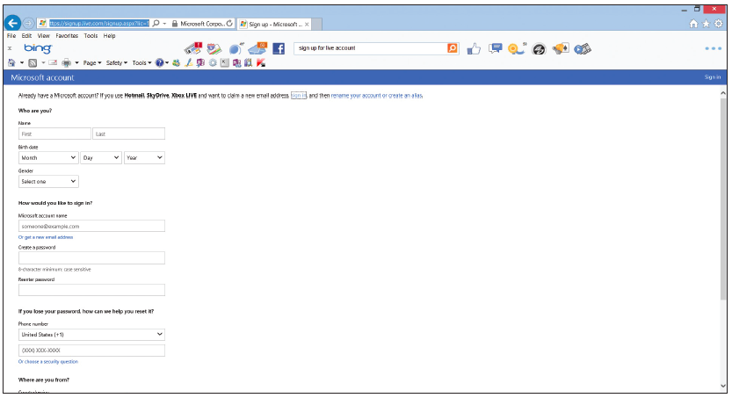
Step by Step: Send Documents via SkyDrive
If you need a Microsoft account, launch the Internet Explorer browser and complete the steps as listed in the website. At the address bar, enter the https://signup.live.com/ site. See below.

Slide 66
Step by Step: Send Documents via SkyDrive
Follow the prompts on your screen to complete the registration for a Microsoft account. Once you complete the process, close Internet Explorer. You will sign in to your account in the Account screen in Word.
Go to Backstage, and then click Account.
Under Sign in to Office, click the Sign In button.
Click Microsoft Account and in the next screen enter your e-mail account and password you just set up for this account.

Slide 67
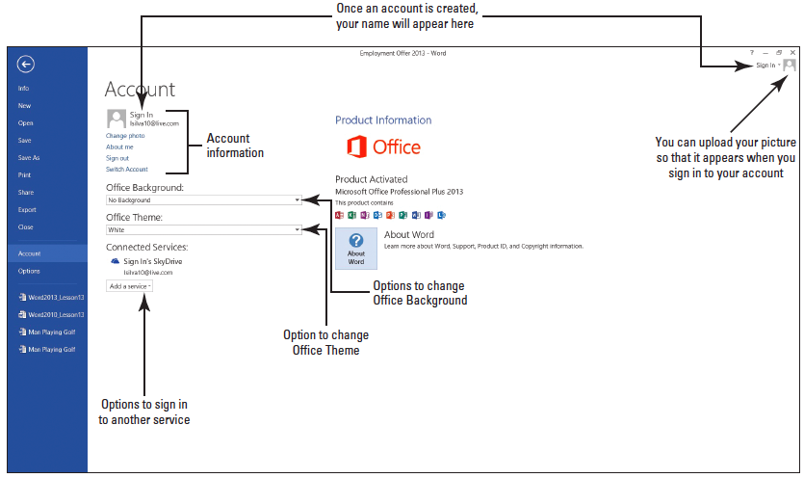
Step by Step: Send Documents via SkyDrive
Once you are connected, the Account screen changes and your personal profile appears. You will be able to upload, create, edit, and share documents (below).

Slide 68
Step by Step: Send Documents via SkyDrive
Select the drop-down arrow by Office Background and scroll through each option. Look at the upper-right corner as the screen background changes.
Select any option.
Select the drop-down arrow by Office Themes and select the Dark Gray and watch how the background color darkens.
Under Add a service, you have additional options to add Images & Videos and videos from your favorite sites. Click YouTube and watch how YouTube is automatically added.

Slide 69
Step by Step: Send Documents via SkyDrive
Click Remove to remove, and then click Yes. It’s that easy to add and remove a service. The second option allows you to store documents to Office 365 SharePoint or SkyDrive. The third option allows you to connect Microsoft Word to Facebook, LinkedIn, or Twitter. Now that you have signed in, you’re ready to share your document via SkyDrive.

Slide 70
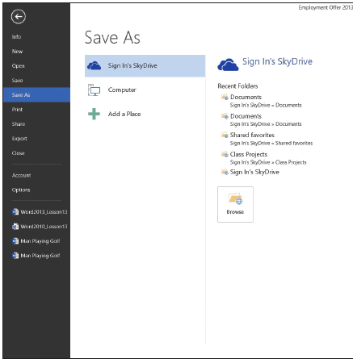
Step by Step: Send Documents via SkyDrive
Click Share on the left pane, then under Invite People, click Save to Cloud. When the screen changes to the Save As screen, select your SkyDrive. On the right side of the screen, the SkyDrive’s folders appear. (Note that your screen will not match the figure at right).
Click Shared favorites and the Save As dialog box opens. This is your SkyDrive location folder and your shared documents are stored here.

Slide 71
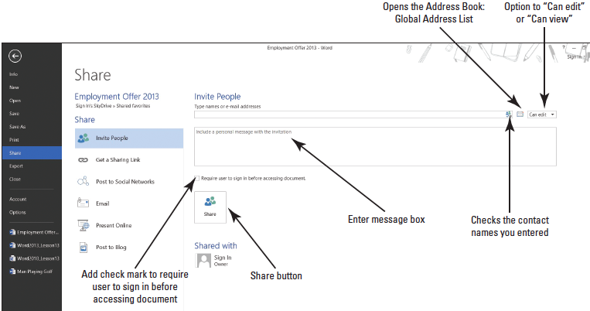
Step by Step: Send Documents via SkyDrive
Click Save. The Share screen changes and now you can share the Employment Offer 20XX letter with anyone by sending them an invite to edit or view the document (below).

Slide 72
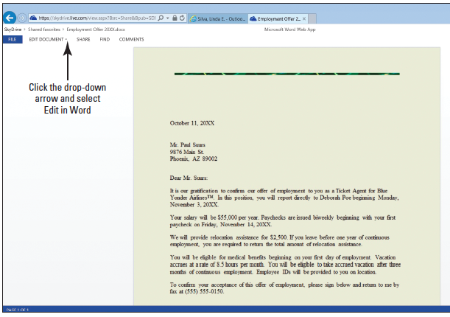
Step by Step: Send Documents via SkyDrive
Select someone in class and type his or her [email address] along with a short message. You can also practice on your own by creating another account for yourself.
Click the Share button and an e-mail is auto- matically sent to him or her.
When he or she opens the e-mail, a link to the document appears. The docu- ment opens in the Microsoft Word Web App and should resemble the figure above.

Slide 73
Step by Step: Send Documents via SkyDrive
The individual receiving the e-mail should be signed in to the Microsoft account before editing the document.On the left pane is the Get a Sharing Link.
This is good for large groups of people or when you don’t know an e-mail address, you can create a link for viewing or editing.
PAUSE. LEAVE the document open for the next exercise.

Slide 74
Step by Step: Send Documents via Internet Fax
USE the document open from the previous exercise.
The Internet Fax is an alternative to having a fax machine because you use your computer to send files via the web. By default the Windows Fax feature is disabled and it must be installed before sending documents via Internet fax. A utility is built into Windows to use the Windows Fax and Scan utility.
Open Backstage, click Share, and then click Email.
On the right side, click Send as Internet Fax.

Slide 75
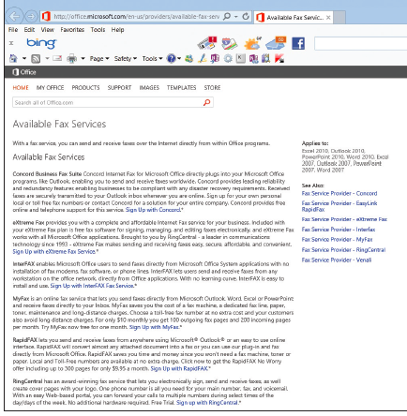
Step by Step: Send Documents via Internet Fax
A prompt appears stating, To use Fax Services to send your fax, you must sign up with a fax service provider. If you click OK, your web browser opens and you choose a provider. Your screen resembles the figure at right. Typically, each fax service provider charges a fee for its services. Check with your instructor to see whether the services are available.

Slide 76
Step by Step: Send Documents via Internet Fax
After a fax service provider is selected and an account is set up, a New Fax window opens with the current document attached. You would complete the fax form and send.
EXIT the Internet.
PAUSE. LEAVE the document open for the next exercise.

Slide 77
Step by Step: Send Documents as PDF or XPS
USE the document open from the previous exercise.
Open Backstage, click Share, and then click Email.
Under Email, click Send as PDF. The Word document automatically saves as a PDF file and the e-mail message screen opens. Type an [email address] and short message, and then click the Send button. The PDF document is shown in the e-mail message as an attachment. You can also send the document as an XPS by following the steps and selecting Send as XPS.
PAUSE. LEAVE the document open for the next exercise.
Notes:
Cross Reference: In Lesson 1, you learn about file extensions and saving files in different file formats.

Slide 78
Step by Step: Post to Social Networks
USE the document open from the previous exercise.
You should already be signed in to your Microsoft account.
In the Account screen, select add a service and select Facebook.
When you click Connect, the Facebook login screen opens.
Once you are connected, you are ready to share documents and photos. There will be additional steps to follow to upload your documents and photos to your Facebook profile.
PAUSE. LEAVE the document open for the next exercise.

Slide 79
Step by Step: Present Online
USE the document open from the previous exercise.
Sharing a Word document by using the Present Online feature is easy because there is no setup.
The Present Online feature allows you to create a link to your document and present to others even if they do not have Word installed on their computer.
The link that you create will open in a browser. In this exercise, a link will be created to share with others to view your document in a web browser.
To use this feature, you must have a Microsoft account to start the online presentation.

Slide 80
Step by Step: Present Online
In Backstage, select the Share group.
Clicking the Present Online button means you agree to the terms. Read the Service Agreement.
Add a check mark by Enable remote viewers to download the document.

Slide 81
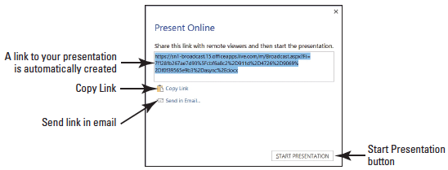
Step by Step: Present Online
After agreeing to the agreement, click Present Online to begin connecting to Office Presentation Services (see below). You have two options available on how to present. You can select Copy Link or Send in Email—send an invitation that links to your presentation.

Slide 82
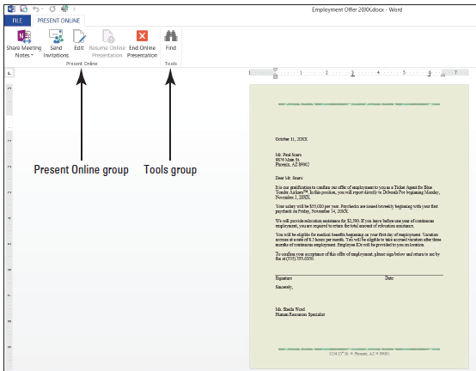
Step by Step: Present Online
Click Start Presentation. Your screen should match the figure at right. You can send invitations and invite others to view your pre- sentation and if you need to edit the document, you can do so in the same screen.
Click End Online Presentation. A warning prompt appears and states, All people will be disconnected if you continue. Do you want to end this online presentation?

Slide 83
Step by Step: Present Online
Click End Online Presentation.
CLOSE the file. When you close the file, you will be prompted to save, and then the file will be saved to your SkyDrive account.
PAUSE. LEAVE the document open for the next exercise.

Slide 84
Step by Step: Register and Publish a Blog Post
OPEN a blank document screen.
You can publish a Word document as a blog post, use a blog template, or create a new blog.
Before you can publish, you need to register for your own blog space.
You will use WordPress as your blog service provider. Create your own space at wordpress.com. The service is free.
Follow the instructions on its home page and use your live account for your e-mail address. You identify a blog address, your user name and a strong password.

Slide 85
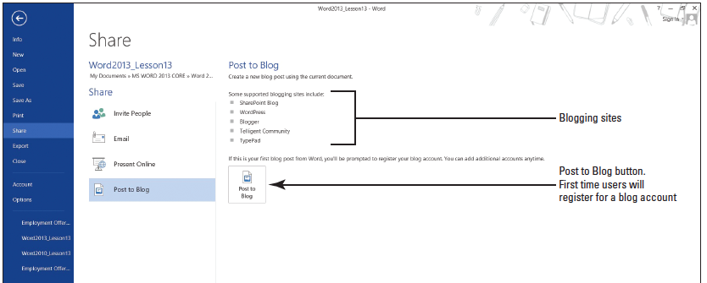
Step by Step: Register and Publish a Blog Post
In Backstage, click Share, and then click Post to Blog. Because this is your first blog, you have to go through the registration process (see below).

Slide 86
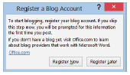
Step by Step: Register and Publish a Blog Post
Click the Post to Blog button. The Register a Blog Account dialog box opens as shown at right.
Click the Register Now button, click the drop-down arrow, select WordPress, and then click the Next button.

Slide 87
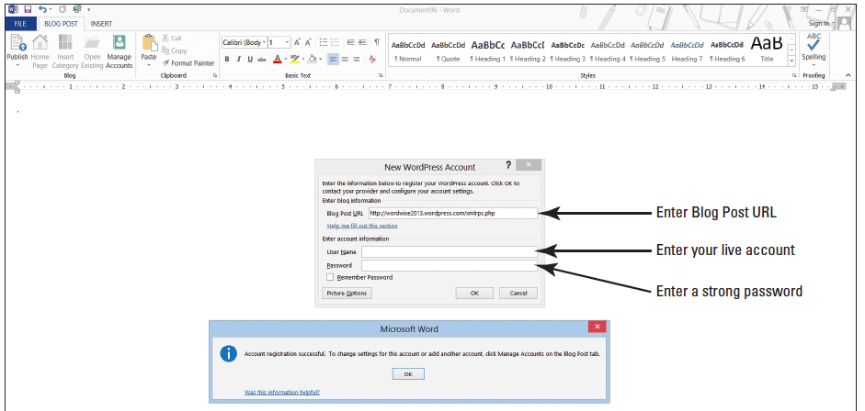
Step by Step: Register and Publish a Blog Post
In the New Press Account, enter a Blog Post URL. For example, http://wordwise2013.wordpress.com/xmlrpc.php is shown below along with the confirmation that the account registration is successful (the user name and password is hidden). Avoid entering this URL because the domain name is already taken.

Slide 88
Step by Step: Register and Publish a Blog Post
Enter any name you would like for your URL and once it displays as being available complete the registration process by creating [your user name] and [your password]. (It should be a strong password—the screen will indicate if it is weak or strong.)

Slide 89
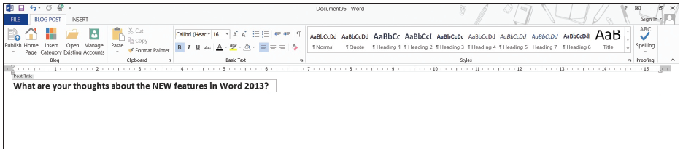
Step by Step: Register and Publish a Blog Post
The Word screen displays [Enter Post Title Here]. Type What are your thoughts about the NEW features in Word 2013? (seebelow). In the Blog group, the Publish button contains two options: Publish and Publish as Draft. After you complete a few more steps, you post and publish your first blog. On the next step, you add your blog URL to your account.

Slide 90
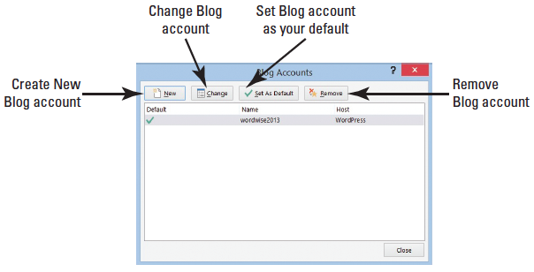
Step by Step: Register and Publish a Blog Post
On the Blog group, click the Manage Accounts button to display the Blog Accounts dialog box as shown below. Under Manage Accounts, you should see your Blog URL.
If you do not see your URL, click the New button. The New Blog Account dialog box opens.

Slide 91
Step by Step: Register and Publish a Blog Post
Click the drop-down arrow to display the menu, select WordPress, and click Next. The New WordPress Account dialog box opens. Enter your Blog Post URL, <Enter your blog URL here>; for example, wordwise2013.wordpress.com, and then enter [your user name] and [your password].
If you would like Word to remember your password, click the Remember Password box to add a check mark.
Another option is Picture Options. When you publish your blog post, your picture needs to be uploaded to a picture provider on its storage location.

Slide 92
Step by Step: Register and Publish a Blog Post
Options to consider if you decide to upload a picture include: You can upload to My blog provider, My own server, and None—don’t upload pictures. For this exercise, do not use the Picture Options.
After entering [your blog post URL], [your user name] and [your password], a prompt appears stating, When Word sends information to the blog service provider, it may be possible for other people to see that information. This includes your user name and password. Do you want to continue? Click Yes.
Click the Manage Accounts button again in the Blog group to see your account. Click Close.

Slide 93
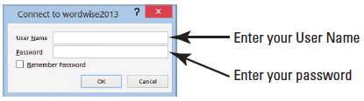
Step by Step: Register and Publish a Blog Post
Click the Publish button on Blog group to display the Connect to [your Blog URL] dialog box. The figure below displays Connect to wordwise2013. Type [your user name] and [your password] to post and publish.

Slide 94
Step by Step: Register and Publish a Blog Post
A prompt appears stating, When Word sends information to the blog service provider, it may be possible for other people to see that information. This includes your user name and password. Do you want to continue? Click Yes.
A gray prompt appears in your Word blog document screen stating, This post was published to <your blog URL site> followed by the time and date; for example, This post was published to wordwise2013 at 7:13:49 PM 1/21/2013.

Slide 95

Step by Step: Register and Publish a Blog Post
When you click the Home Page button on the Blog group, it automatically connects the Internet directly to your Blog URL website after you have logged in.
The Insert Category button allows you to categorize postings on your blog. When you click on this button, you are prompted to log in again. When you categorize your blog post, you can select from the drop-down menu. In the meantime, you do not see any category. If you clicked on the Insert Category button, click the Undo button on the Quick Access Toolbar to remove. The Open Existing button opens a published blog.
Notes:
Take Note: You can blog and publish from your blog URL site.

Slide 96
Step by Step: Register and Publish a Blog Post
CLOSE the blog post. A prompt might appear stating, Do you want to save changes made to the document? If you click “Don’t Save,” a recent copy of this file will be temporarily available. Click Save. Use the default name and save to your lesson folder on your flash drive.
PAUSE. LEAVE Word open for the next exercise.

Slide 97
Step by Step: Publish a Word Document as a Blog
OPEN the Employment Offer 20XX document from the lesson folder. You are now ready to publish an existing Word document as a blog.
Go to Backstage, and click Share. Click Post to Blog, and then click the Post to Blog button. The Employment Offer 20XX document is inserted in the Word Blog layout and appears below the horizontal line.
Click the Publish button in the Blog group to display Connect to <your Blog URL site>, Connect to wordwise2013. Enter your user name and password, and then click OK.

Slide 98
Step by Step: Publish a Word Document as a Blog
A prompt appears stating, When Word sends information to the blog service provider, it may be possible for other people to see that information. This includes your user name and password. Do you want to continue? Click Yes.
A gray prompt appears on the screen stating, This post was published to your <Blog URL site> at time is displayed and date.
SAVE the blog post with the default name in the lesson folder on your flash drive.
CLOSE the Employment Offer 20XX document.
PAUSE. CLOSE Word.

Slide 99
Step by Step: Remove a Blog on Your Blog Site
LAUNCH your Internet browser and log in to your WordPress 2013 blog. On the left side of the screen, click Post, and then click All Posts.
Add a check mark in the check box, and then select Trash.
Log out of your blog URL site.
Have fun blogging!
CLOSE the Internet.

Slide 100
Skill Summary

